Slide 1
Anonymous Animal Chat Room
ACC Final TLDR
Brian Lu

Slide 2
Description (Proposal)
An semi-anonymous chat room, where users can choose a topic room to join and chat in real-time.
Users will only be able to send plain text messages (tentative).
Users will be able to generate a randomized nickname, like the Google Doc Animal names.

Slide 3
Description
An semi-anonymous chat room, where users can choose a topic room to join and chat in real-time.
Users will only be able to send plain text messages and images.
Users will be able to generate a randomized nickname, like the Google Doc Animal names.
Users can leave by simply closing their window or tab.
Sound notifications for new messages.

Slide 4
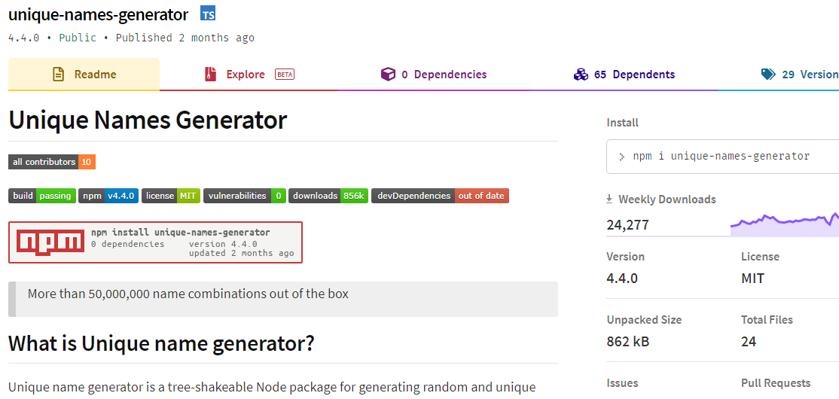
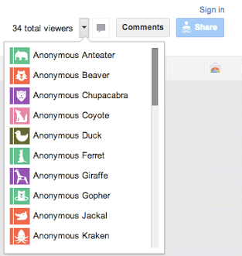

Slide 5









Tech Chart
DNS, HTTP, TCP/IP
TCP/IP

Slide 6
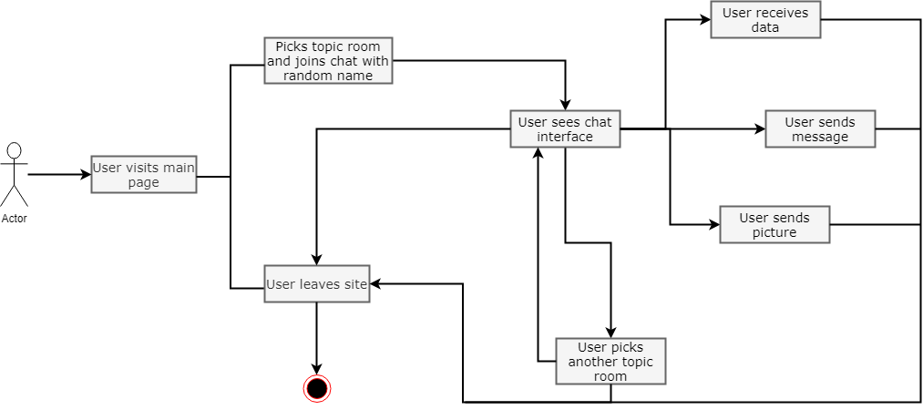
User Flow Chart

Slide 7
Issues
React-Chat-Engine did not have an API that would send socket connection information to front end.
Recently made, so docs were not the most descriptive and only a miniscule amount of stackoverflow posts.
Frequently ran into authentication errors with their API functions, resorted to using their REST API calls.

Slide 8
References
Docs: https://chatengine.io/docs
REST API Docs: https://rest.chatengine.io/#intro
Unique Name Generator: https://www.npmjs.com/package/unique-names-generator

